Slide 1
Using Machine Learning to Classify ORS Task Data
Rebecca Hu
Civic Digital Fellow
Office of Compensation and Working Conditions
Demo Day
August 8, 2019

Slide 2
Project Overview
Goal: Classify work task data from the Occupational Requirements Survey (ORS) into General Work Activities (GWA)
Phase 1: Use Occupational Information Network (O*NET) data to train a machine learning model to classify work tasks into GWA
Phase 2: Use the trained model to classify ORS work task data into GWA

Slide 3
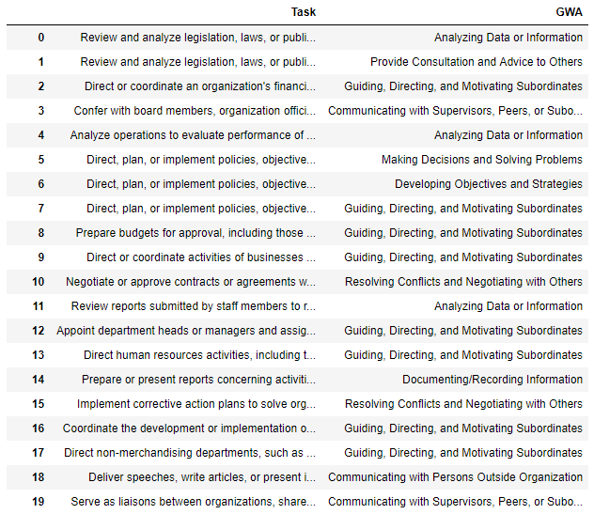
The Data
A subset of the O*NET data
Pure text
One column of task data
One column of GWA labels
Significant class imbalance problem

Slide 4
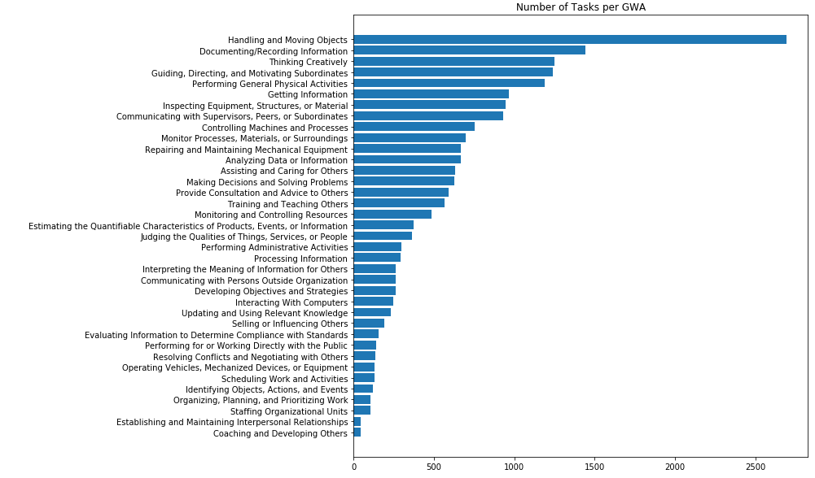
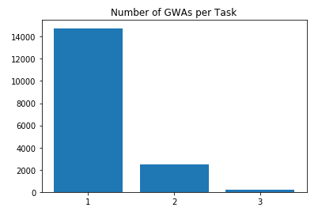
A Multiclass AND Multi-label Problem

Slide 5
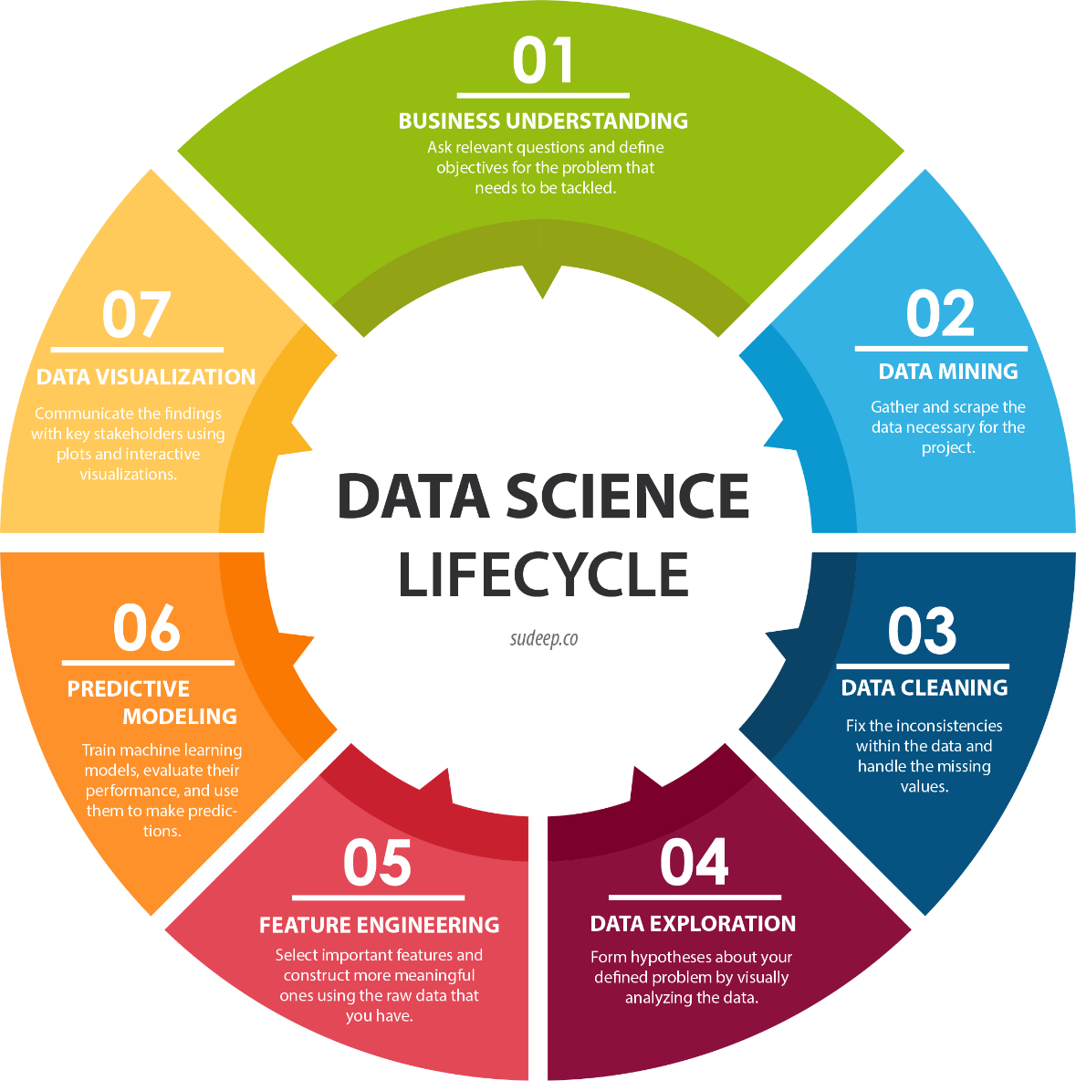
Phase 1: O*NET
Merging the Data
EDA
Pre-processing
Classification Model
Evaluation

Slide 6
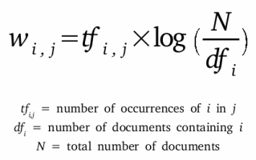
Pre-processing
Remove numbers, punctuation, stopwords
Stemming
TF-IDF
N-grams
Original Text
“Contact applicants or creditors to resolve questions about applications or to assist with completion of paperwork.”
Pre-processing
['applic', 'applicants creditor', 'applicants creditors resolv', 'applicants creditors resolve quest', 'applicants creditors resolve questions appl', 'applications assist', 'applications assist complet', 'applications assist completion paperwork', 'assist', 'assist complet', 'assist completion paperwork', ………… ,'creditors resolve questions applications assist', 'paperwork', 'question', 'questions appl', 'questions applications assist', 'questions applications assist complet', 'questions applications assist completion paperwork', 'resolv', 'resolve quest', 'resolve questions appl', 'resolve questions applications assist', 'resolve questions applications assist complet' ]
TF-IDF Matrix
[[0.32879797, 0.16439899, 0.16439899, 0.16439899, 0.16439899, 0.16439899, 0.16439899, 0.16439899, 0.16439899, 0.16439899, 0.16439899, 0.16439899, 0.16439899, 0.16439899, 0.16439899, 0.16439899, 0.16439899, 0.16439899, 0.16439899, 0.16439899, 0.16439899, 0.16439899, 0.16439899, 0.16439899, 0.16439899, 0.16439899, 0.16439899, 0.16439899, 0.16439899, 0.16439899, 0.16439899, 0.16439899, 0.16439899, 0.16439899]]

Slide 7
Classification Model
After benchmarking some models, we decided to use the Logistic Regression implementation from scikit-learn as our baseline
Use One-vs-Rest technique for multi-labels
Binarize the data
Oversample the target class and under-sample the rest
Train & Combine results of 41 unique classifiers for final predictions

Slide 8
One-vs-Rest Technique: Binarize

Slide 9
One-vs-Rest Technique: Sample

Slide 10
One-vs-Rest Technique: Train & Combine
Final Model
Handling and Moving Objects
Analyzing Data or information
Controlling Machines and Processes
…
Developing Objectives and Strategies

Slide 11
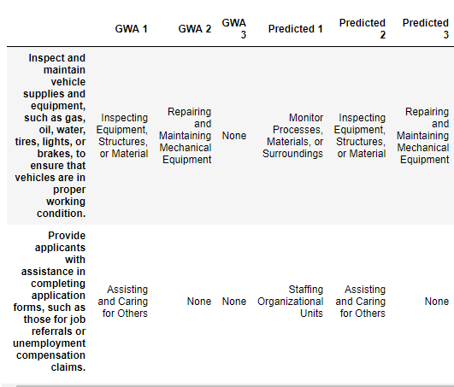
Tasks
Model Results
Because the labels of the O*NET data overlap, it is difficult to gauge how well the model is truly performing.
By looking through the results, in general, it seems the model does a decent job about predicting related labels
It over-labels GWA, thus favoring recall over precision, which is preferred for our purposes.

Slide 12
Phase 2: ORS
(ORS data is private so it is not displayed here)
Clean ORS data
Use pre-trained models to predict labels
ORS has no “ground-truth” GWA labels so difficult to evaluate the accuracy of the model
Can evaluate SOC codes, but not a reliable metric

Slide 13
Challenges
O*NET labels are similar, and their descriptions overlap
The majority of tasks are only labelled with one label, but the model will predict many similar labels
No way to measure if the predicted label is wrong but close
Thus, quantitative metrics are unreliable
O*NET and ORS data tasks are written differently
ORS data has no GWA labels

Slide 14
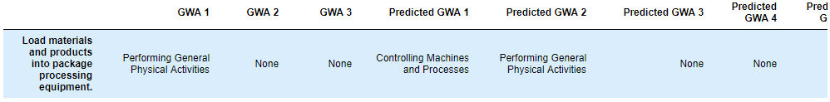
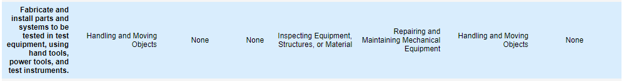
O*NET Tasks
€
O*NET Labels
Predicted Labels

Slide 15
Rebecca Hu
Civic Digital Fellow
Office of Compensation and Working Conditions
www.bls.gov/ORS
Hu.Rebecca@bls.gov

